Slide 1


CAPSTONE PROJECT
OF WEATHER ANALYSIS

Slide 2
INITIATION OF MY PROJECT
Weather is the ever-changing condition of the atmosphere around us—it shapes our daily lives, affects how we travel, what we wear, and even what we eat. From bright sunny days to sudden thunderstorms, weather is nature’s way of expressing itself. It is influenced by various factors such as temperature, humidity, wind, pressure, and precipitation. Studying weather is not just about predicting rain or sunshine—it helps us prepare for natural disasters, understand climate change, and improve our agricultural and economic planning. With the help of modern technology and data analytics, weather forecasting has become more accurate and essential than ever . In this project, we dive into the patterns, trends, and impacts of weather, exploring how it varies across regions and time. Join us as we uncover the science behind the sky and the secrets it holds.

Slide 3



The main objective of this weather project is to analyze and understand weather patterns across different regions and time periods using available data. This includes examining key atmospheric elements such as temperature, humidity, wind speed, and precipitation, and identifying trends, anomalies, and regional variations.
This project focuses on analyzing weather data across different countries and cities to identify key patterns and variations. Using visual tools like bar charts and heatmaps, we explore metrics such as temperature, wind speed, and humidity. The analysis reveals regional weather trends and helps us understand how atmospheric conditions vary globally.
The goal of this weather analysis is to understand and interpret climate patterns across different regions by examining key factors like temperature, humidity, and wind speed. By visualizing this data, we aim to uncover trends, identify anomalies, and support smarter decisions in areas such as agriculture, disaster preparedness, and urban planning.

Slide 5
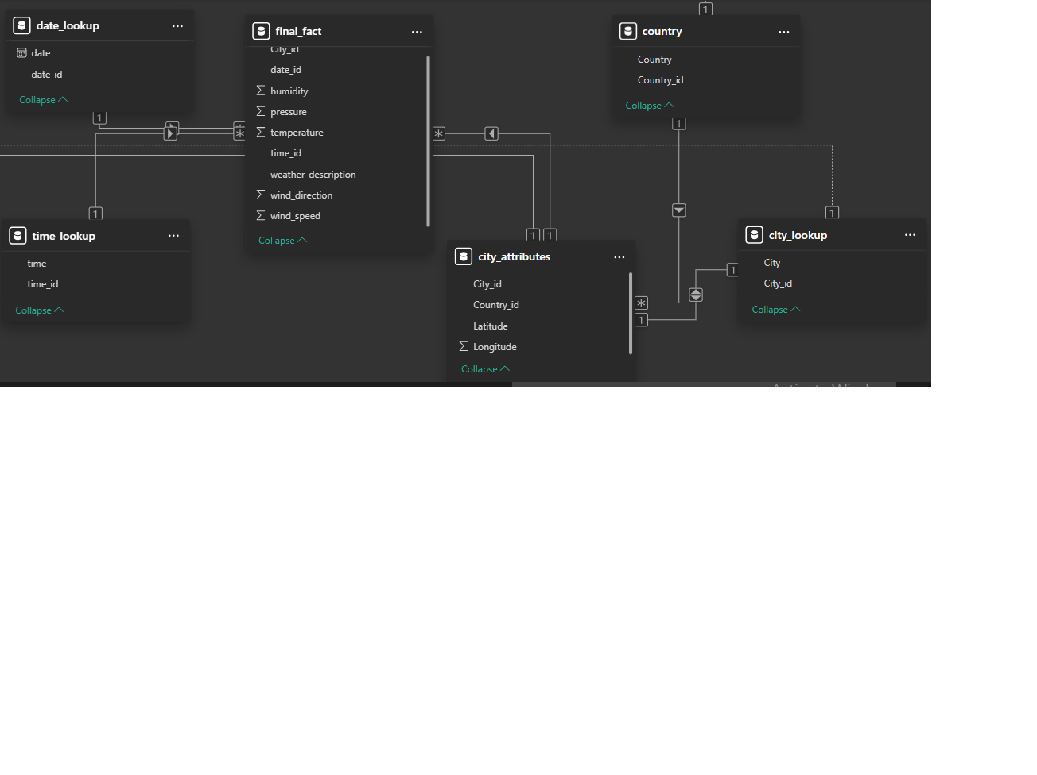
ER DIAGRAM

Slide 6

POWER BI PROBLEM STATEMENTS

Slide 8
Can you create a geographical map in power BI showing the distribution of cities in the dataset based on their latitude and longitude?
CONCLUSION: As per my conclusion the map shows the geographical distribution of cities based on their latitude and longitude. Most of the cities are concentrated in North America, especially the United States, indicating a regional focus in the dataset. This distribution influences the overall weather patterns observed in the analysis.

Slide 9
In power BI, can you create a bar chart representing the top 10 countries with the highest number of cities in the dataset?
CONCLUSION: as per my conclusion This bar chart shows the number of cities included in the dataset from each country. The United States has the highest city count (27), followed by Israel (6) and Canada (3), indicating that the analysis is largely based on data from the U.S. region.

Slide 10
How does the distribution of cities in terms of latitude vary across different continents? Create a scatter plot in power BI to illustrate this.
CONCLUSION :my analysis is saying that this scatter plot represents the latitude distribution of various cities, showing how they are spread across different geographical zones. Most cities fall within the 30° to 45° latitude range, indicating they are located in temperate regions, which significantly influences their weather patterns.

Slide 12
Create a line chart in Power BI to display the temperature trends over time for a selected city. Highlight extreme temperature events.
CONCLUSION :This line and area chart shows the maximum temperatures for Portland and Vancouver across different months. Both cities experience peak temperatures during July and August, with a clear seasonal pattern of rising temperatures from winter to summer and falling afterward. This indicates a typical temperate climate with well-defined seasonal variation.

Slide 13
How does humidity vary across different cities? Generate a heatmap in Power BI to visualize this variation.
CONCLUSION: This map visualizes the minimum humidity levels across various cities based on their geographic locations (latitude and longitude). The concentration of data points is highest in the United States and parts of the Middle East, showing regional humidity variations.

Slide 14
Can you create a time-series chart in Power BI showing the relationship between wind speed and air pressure for a specific city?
CONCLUSION: The graph shows that both wind speed and pressure generally peak during October and December, indicating higher atmospheric activity in these months. A significant dip is observed in May, suggesting relatively calm weather conditions. This trend helps identify seasonal patterns in weather behavior.

Slide 16
Create a time-series line chart in Power BI to show the overall temperature trends over the entire dataset.
CONCLUSION :The chart shows a recurring seasonal pattern in average temperature, with clear peaks and dips each year from 2013 to 2017. Temperatures consistently rise in the middle of each year and drop by year-end, indicating strong seasonal effects on temperature trends.

Slide 17
Can you create a heatmap in Power BI to visualize the busiest hours for specific weather conditions (e.g., "clear sky," "rainy")?
CONCLUSION :The chart shows a recurring seasonal pattern in average temperature, with clear peaks and dips each year from 2013 to 2017. Temperatures consistently rise in the middle of each year and drop by year-end, indicating strong seasonal effects on temperature trends.

Slide 18
How does the wind speed change over the course of a day? Create a radial chart in Power BI to represent this.
CONCLUSION :The radial chart shows that wind speed tends to peak around October and November, with relatively lower values during the summer months. This indicates a seasonal pattern where wind intensity increases during the post-monsoon or early winter period.

Slide 20
Conclusion:
Create a Power BI chart comparing the temperature variations between two selected cities over a specific timeframe.
CONCLUSION: The chart illustrates a clear fluctuation in maximum temperature over time, showing a steady decline during early hours followed by a sharp rise in the afternoon. This trend suggests typical daily temperature variation influenced by sunlight exposure, likely consistent across both selected cities.

Slide 21
Can you build a heatmap in Power BI to show the temperature ranges for cities across different countries?
CONCLUSION :The map highlights the geographical distribution of temperature averages across various cities. The intensity of the circles indicates that certain regions in North America experience higher average temperatures compared to others, suggesting regional climate variations influenced by location-specific factors such as latitude and altitude.

Slide 22
Create a bar chart in Power BI to highlight cities with the highest and lowest average temperatures in the dataset.
CONCLUSION :The chart compares maximum, minimum, and average temperatures for Vancouver and Portland. Both cities show a similar temperature distribution, indicating consistent climatic behavior. However, Portland shows slightly higher maximum temperature proportions, suggesting warmer conditions compared to Vancouver.

Slide 24
Create a wind rose chart in Power BI to visualize the prevailing wind directions for a selected city.
CONCLUSION : The chart reveals that Vancouver has a significantly higher total wind direction value compared to Portland, indicating stronger or more variable wind patterns in Vancouver. This suggests that Vancouver may experience more dynamic wind conditions than Portland.

Slide 25
Can you generate a Power BI heatmap illustrating the average wind speeds across cities for different months of the year?
CONCLUSION : The map shows that Vancouver experiences slightly higher average wind speeds compared to Portland. This indicates that Vancouver may be more exposed to coastal wind influences, while Portland experiences relatively calmer wind conditions.

Slide 26
Create a Power BI scatter plot to show the relationship between wind speed and air pressure for a specific city.
CONCLUSION :The chart shows an inverse relationship between wind speed and atmospheric pressure across the two cities. Vancouver, with higher wind speed, corresponds to lower pressure, while Portland shows higher pressure with lower wind speed, indicating a typical meteorological pattern where wind intensifies as pressure decreases

